Slide 1
Six Sigma The DMAIC Process Reducing Process Variation Catapult Exercise
BUSI 104 – Operations Management
Professor Arnheiter

Slide 2
Six Sigma Improvement Process; Project-Oriented
Define
Measure
Analyze
Improve
Control
Often referred to as the “DMAIC” Process
These phases typically require a total of 4-6 months
This phase is typically 12 months in duration

Slide 3
Six-Sigma Elements
Projects
Human Aspects
Six-Sigma
Metric
Statistical Tools
Profitability

Slide 4
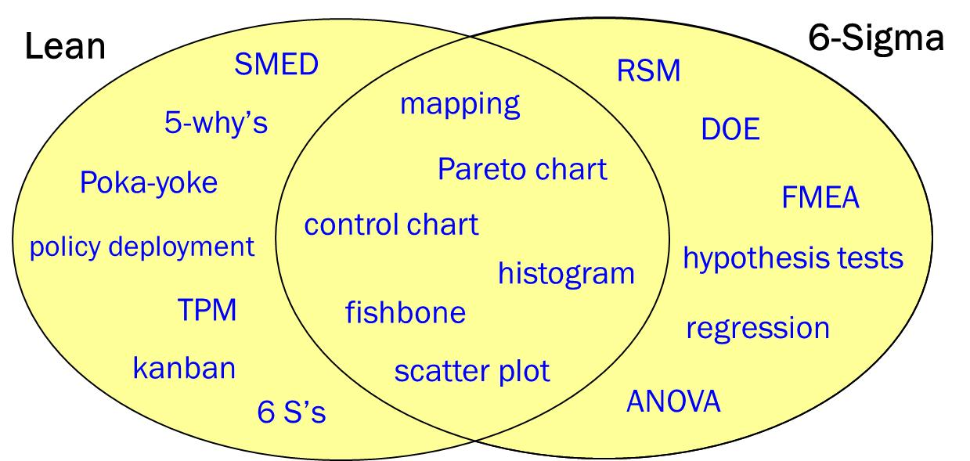
How are Lean and Six Sigma Related? Main Methodologies Overlap

Slide 5
Phase I: Define Key Questions and Steps
Identify customer requirements and stakeholders
Form team and “frame” project
Write the Problem Statement
Create Input-Process-Output (IPO) Diagram and select which metrics you plan to capture

Slide 6
Phase II: Measure
Map current state of the process
How is the process measured? Are the measurements accurate and precise?
Collect baseline data for key performance metrics (e.g., summary statistics – mean, variance, standard deviation, range, distribution shape, etc.)

Slide 7
Phase III: Analyze
What types of waste are apparent? Assess using DOWNTIME principle.
Are the metrics centered or off target?
Does the process exhibit large variation? What are the sources of variation?
Identify potential root causes of the problem
What would a world class process look like?

Slide 8
Phase IV: Improve
How can we remove causes of waste?
What is list of improvements to be made?
Is pilot study feasible to test improvement ideas?
What is projected performance of improved process? Ideally, this is based on pilot study.
What is projected cost savings? Monthly, annual, etc.

Slide 9
Phase V: Control
How do you propose to sustain the process improvements?
Validate benefits going forward (typically monitored for 1 year after end of Improve phase).
Monthly or quarterly actual cost savings are often tracked.

Slide 10
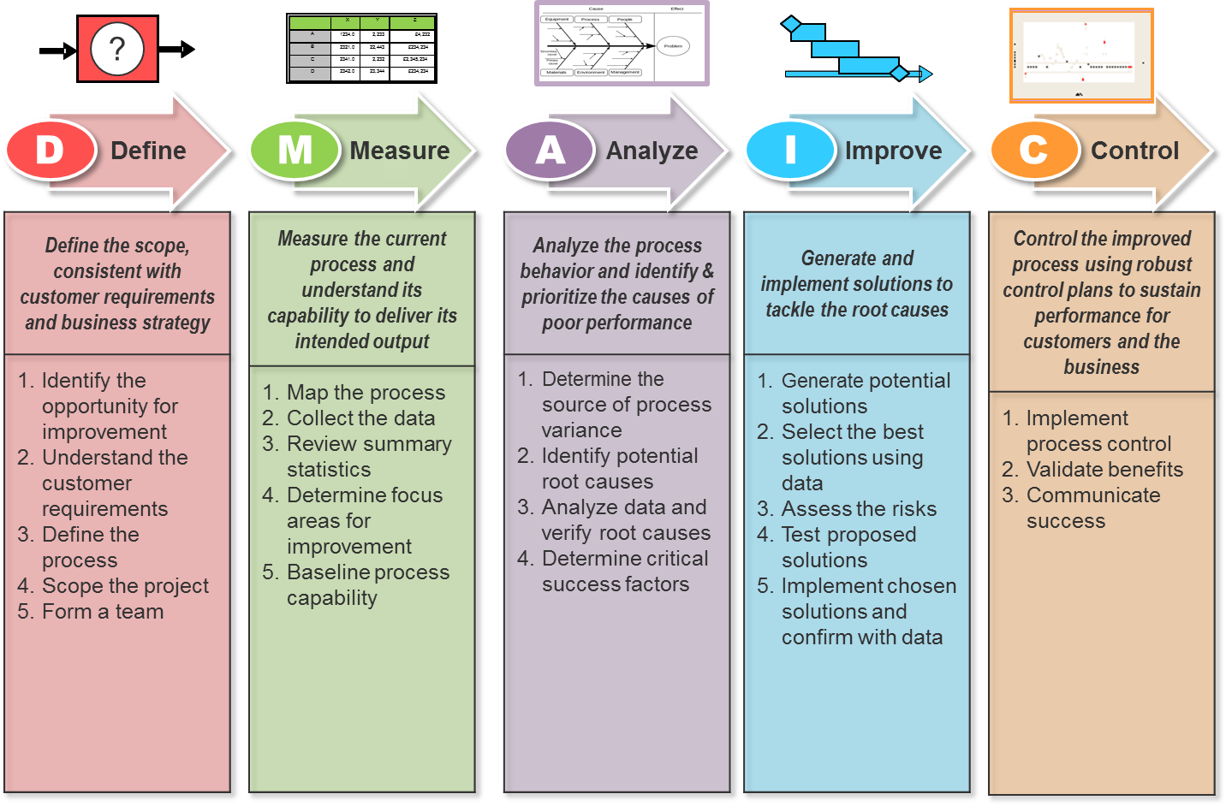
DMAIC Summary

Slide 11
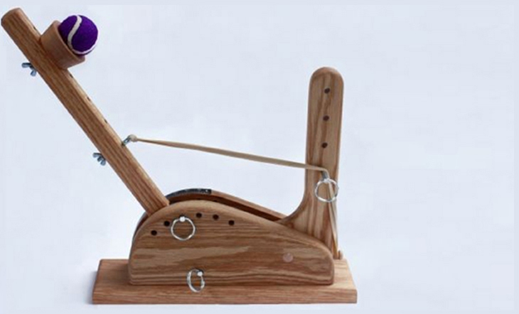
“Statapult” Exercise: Reducing Variation using DMAIC Process

Slide 12
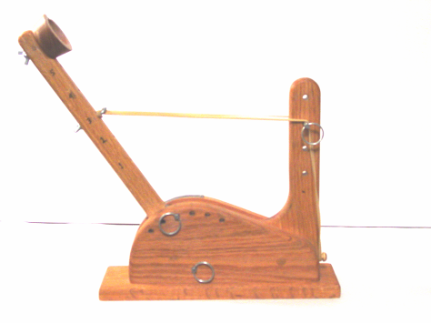
“Statapult” Safety
Keep your hand from being pinched by the stop pin and arm.
Do not get too close to the catapult while launching.
Do not allow the measuring tape to cut you while being rewound.
Safe Holding Zone

Slide 13
Round 1: Quick-Fire Launching
Use only the “Statapult”, measuring tape, and ball.
Agree on a launching sequence for team members.
NO practice shots!
Each launcher will shoot an equal number of shots. Instructor will specify how many total data points to collect (depends on team size).
Pull arm back to 172 degrees. Do not change pin settings.
All shots MUST be launched within 15 seconds, including switching launchers.
Measure distance from back of statapult base to where ball first hits.
Unobstructed launch area (cannot launch into walls, etc.).
Measure in inches or centimeters (instructor will specify).
Record your results, including the range (max – min).
Enter team results on Instructor’s template.

Slide 14
Statapult Round #1 - Data Sheet
Shot | Launcher Name | Distance | Shot | Launcher Name | Distance
1 |  |  | 16
2 |  |  | 17
3 |  |  | 18
4 |  |  | 19
5 |  |  | 20
6 |  |  | 21
7 |  |  | 22
8 |  |  | 23
9 |  |  | 24
10 |  |  | 25
11 |  |  | 26
12 |  |  | 27
13 |  |  | 28
14 |  |  | 29
15 |  |  | 30

Slide 15
Round 2 Preparation
Key to Variance Reduction - PF/CE/CNX/SOP
Create process flow (PF) diagram
Create Cause-and-effect diagram (CE) w/6 M’s
For Example, Measurement as a source of variation:
Accuracy of metal tape measure
Movement of tape measure
Estimating landing point
etc.
CNX – Constant, Noise, Experimental
C = Constant – things that don’t vary – e.g., pin location
N = noise – something that fluctuates
Attempt to convert noise variables to constants whenever economically possible
SOP – Standard Operating Procedure

Slide 16
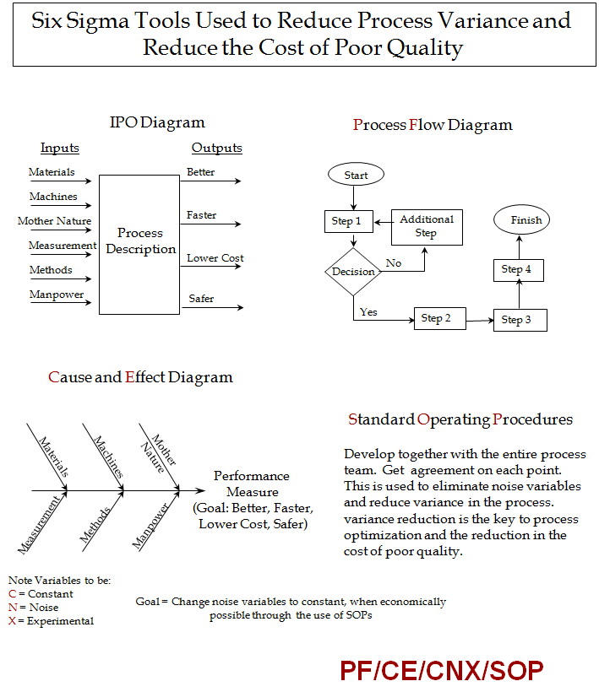

Slide 17
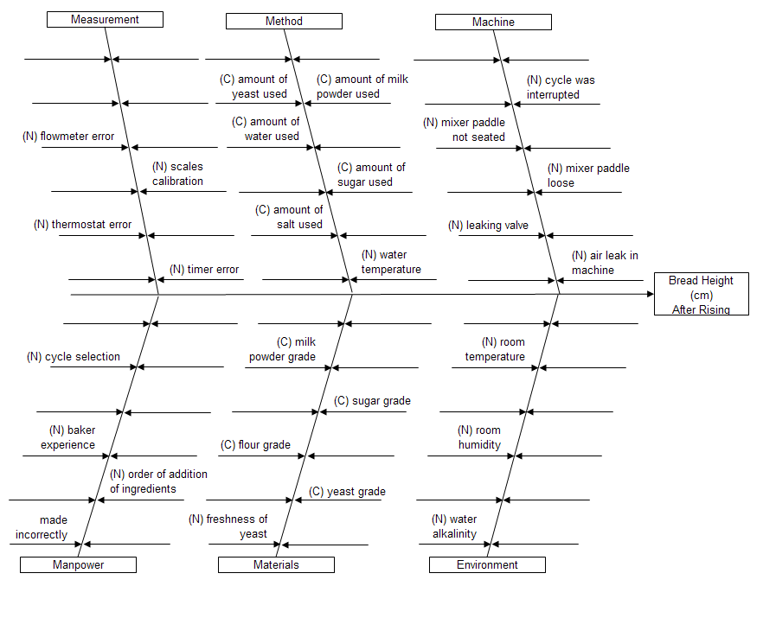
Cause and Effect (CE) Diagram Example

Slide 18
Round 2: Improved Launch
Follow a “mini-DMAIC” Approach
Develop Input-Process-Output diagram (optional).
Create current State Process Flow (PF) diagram.
Draw Cause and Effect (CE) diagram.
Label input variables on CE diagram as (C) Constant or (N) Noise.
Instructor will review and provide items to help with your improved SOP.
Write SOP to convert some (N) noise variables to constants (C).
Pull arm back to 172 degrees, fire shots within 15 seconds each. Do not change pin settings.
Each launcher will shoot an equal number of shots (same total as round 1).
You are allowed one practice shot.

Slide 19
Statapult Round #2 - Data Sheet
Shot | Launcher Name | Distance | Shot | Launcher Name | Distance
1 |  |  | 16
2 |  |  | 17
3 |  |  | 18
4 |  |  | 19
5 |  |  | 20
6 |  |  | 21
7 |  |  | 22
8 |  |  | 23
9 |  |  | 24
10 |  |  | 25
11 |  |  | 26
12 |  |  | 27
13 |  |  | 28
14 |  |  | 29
15 |  |  | 30

